Slide 1

Motion Transfer based on Generative Adversarial Networks
Kun Wu, Chen Luo
April 9, 2020
¹ Department of Electrical Engineering & Computer Science, Syracuse University, Syracuse, NY 13244, USA

Slide 2
Outline
Background
Motion Transfer
Pix2pix Model
Contribution
Experiments
Dataset

Slide 3
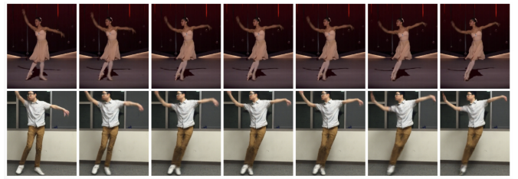
Background
Motion Transfer:
Given a training set of target person images with different motions or poses, the task aims to train a model that can synthesize novel target person images with arbitrary motions from another source person.
Notes:
Here is an example in this figure.
The target person is the person in the second row.
After the training is completed, we can transfer the pose of the person dancing in the first row to the person in the second row.

Slide 4
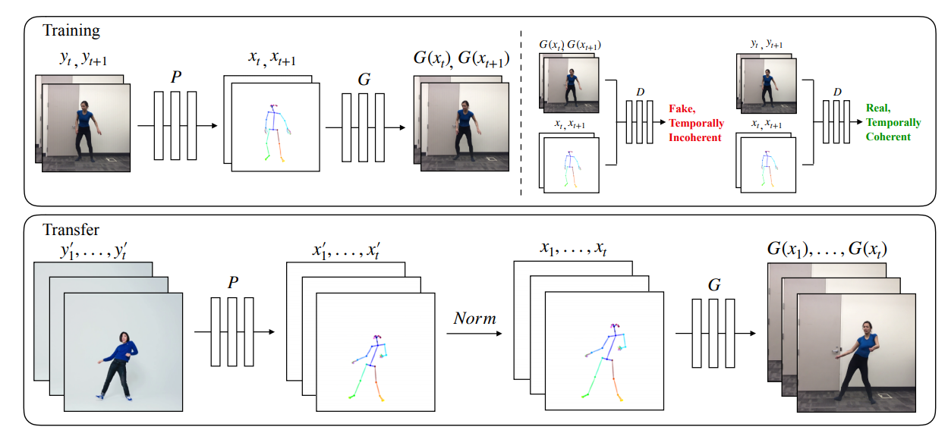
Background
Related work: Everybody Dance Now https://arxiv.org/abs/1808.07371 ICCV 2019
Notes:
Our project is inspired by the related work Everybody dance now. It is accepted by ICCV 2019.
The basic idea is that it uses P, which is a pose estimator to extract the key points of a source person.
Then a generator takes the keypoint images as input and recovers the original images with the background and the appearance of the target person during the training.
During the transfer phase, it extracts the keypoints f another source person and synthesize a target person image.

Slide 5
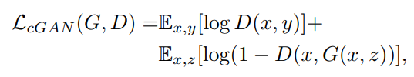
Background
Pix2pix Network:
GANs are generative models that learn a mapping from random noise vector z to output image y, G : z → y . In contrast, conditional GANs learn a mapping from observed image x and random noise vector z, to y, G : {x, z} → y. The generator G is trained to produce outputs that cannot be distinguished from “real” images by an adversarial trained discriminator, D, which is trained to do as well as possible at detecting the generator’s “fakes”.
Objective:

Slide 6
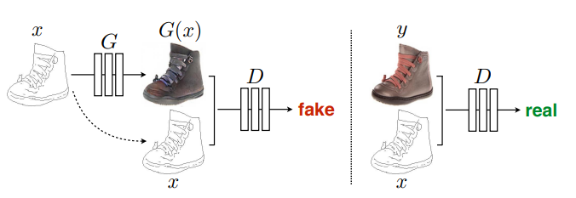
Network Architecture
Training a conditional GAN to map edges→photo. The discriminator, D, learns to classify between fake (synthesized by the generator) and real {edge, photo} tuples. The generator, G, learns to fool the discriminator. Unlike an unconditional GAN, both the generator and discriminator observe the input edge map.

Slide 7
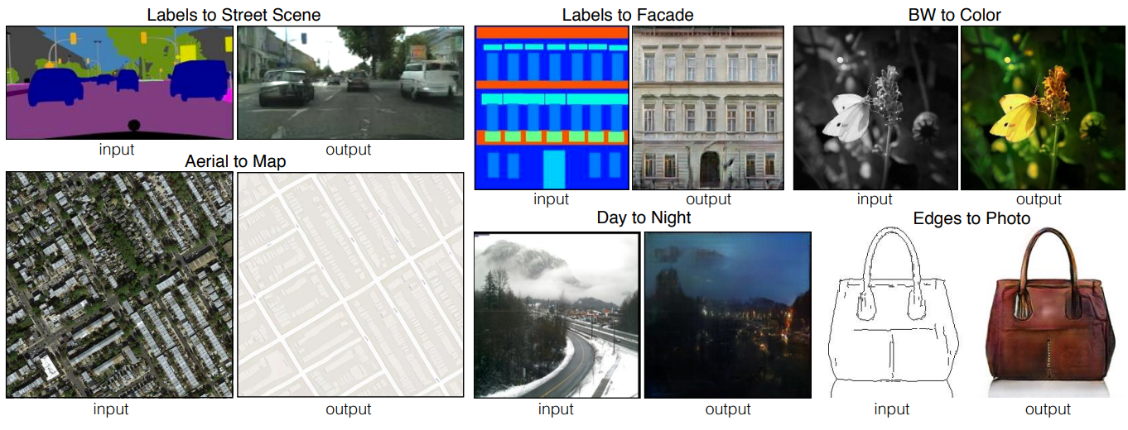
Pix2pix Result

Slide 8
Contribution
Since pix2pix model is a general image to image translation model and the paper does not handle the motion transfer task.
We aim to combine pix2pix with pose estimation technology to do the motion transfer task.

Slide 9
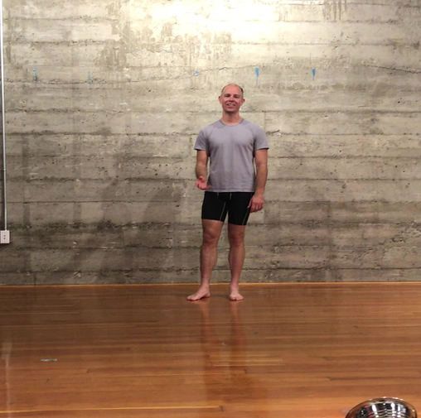
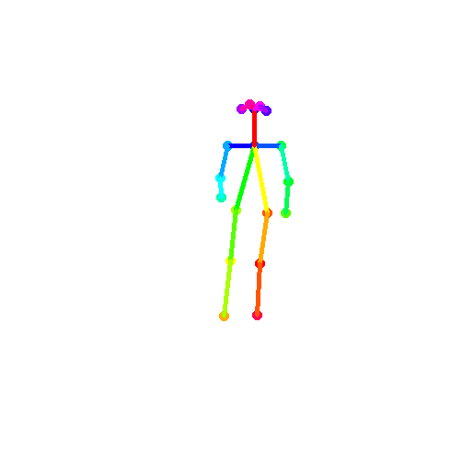
Dataset
Original Dataset: 5 different subjects, 10k+ images for each. 1024 * 512. Everybody Dance Now https://arxiv.org/abs/1808.07371
Modified Dataset: 5 different subjects, sampled 1000 images for each. Cropp and resize to 256 * 256

Slide 10
Q&A
Thank you!

